Slide 1

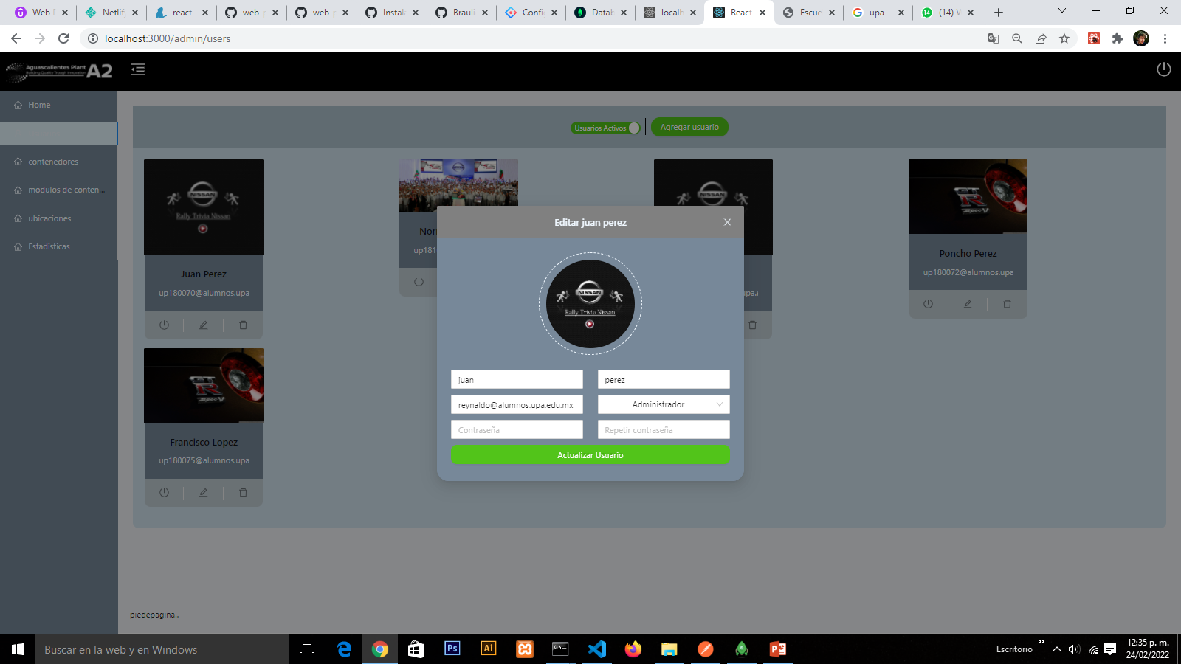

PROJECT:
Aplicativo para la evaluación de la revisión de la clasificación
KPI’s :
Compliance with global Nissan policy
Impact on classification revision time
Rodriguez Alvarez Braulio
MAIN ACTIVITIES:
Develop a web system for the administrative management of the revision of the classification.
Develop a mobile application for the review of the classification.
Universidad Politécnica de Aguascalientes
Ingeniería en sistemas estratégicos de la información
Area: Control Ambiental
Manager: Ribera Flores Marcos Antonio
Supervisor: Echeverría Rodríguez Reynaldo Amílcar
MAIN LEARNINGS:
How is waste management.
Classification Evaluation Process

Slide 2
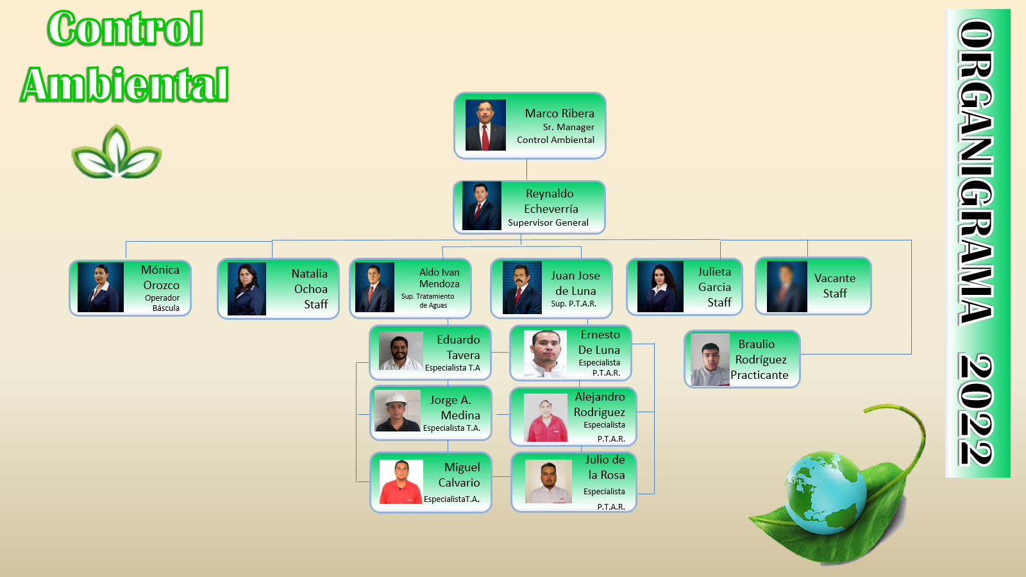
1.-SELECTION OF THE SUBJECT

Slide 3
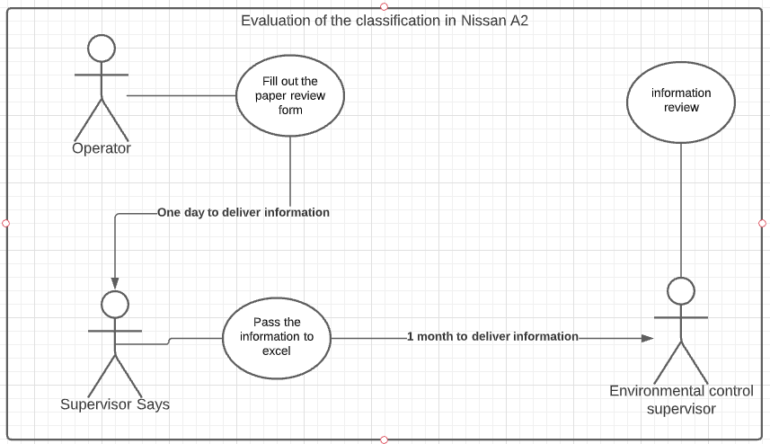
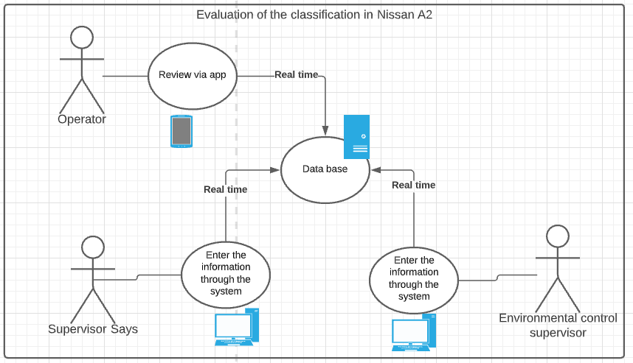
2.-REASON FOR THE SELECTION
Automation of the classification review process to maintain data in real time
Actual process
Process with the system running

Slide 4
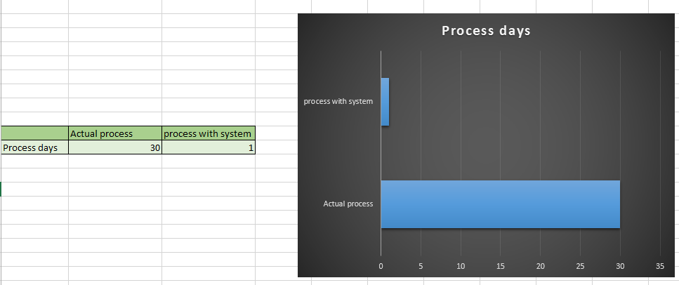
2.-REASON FOR THE SELECTION

Slide 5
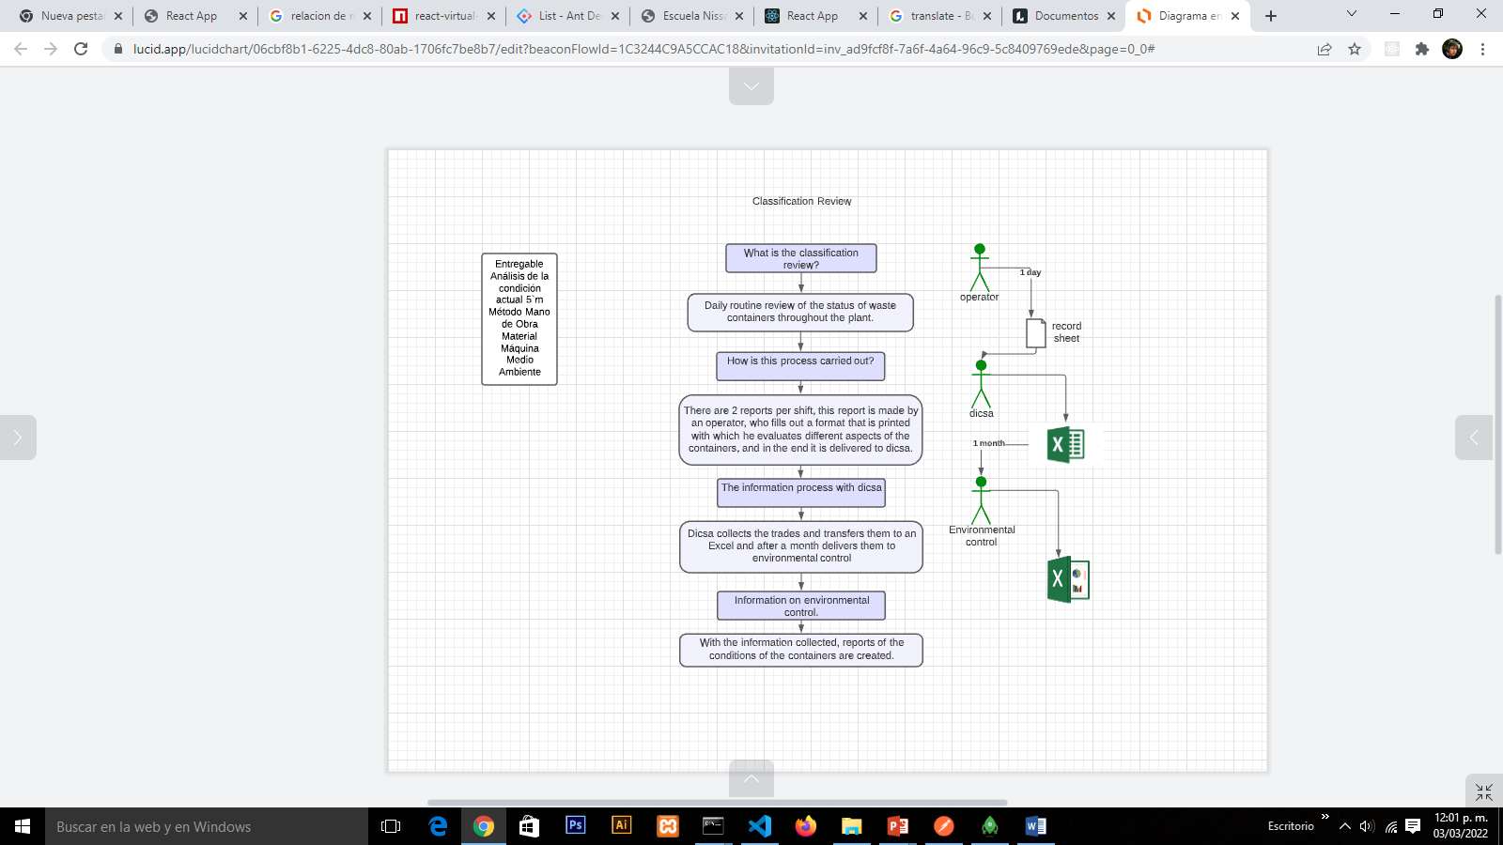
3.-KNOWLEDGE OF THE CURRENT SITUATION

Slide 6
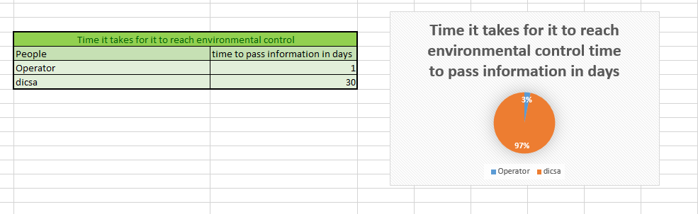
3.-KNOWLEDGE OF THE CURRENT SITUATION

Slide 7
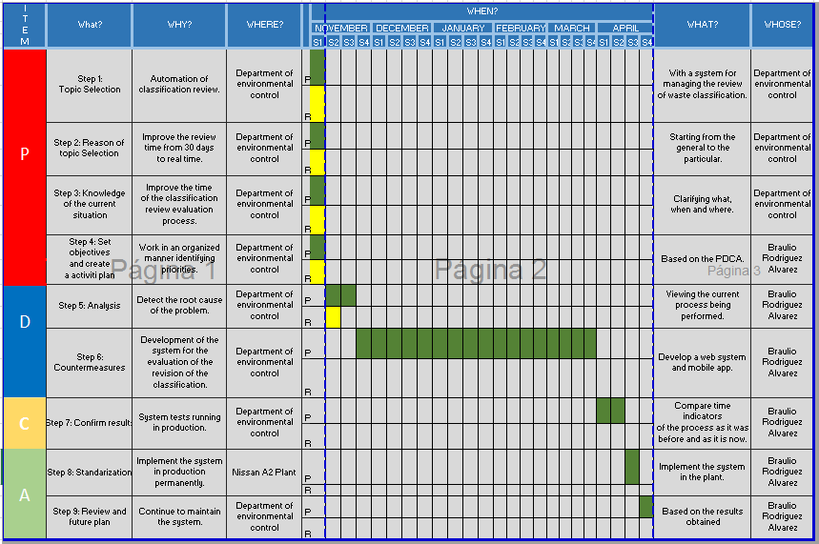
4.- Create an Activity Plan

Slide 8
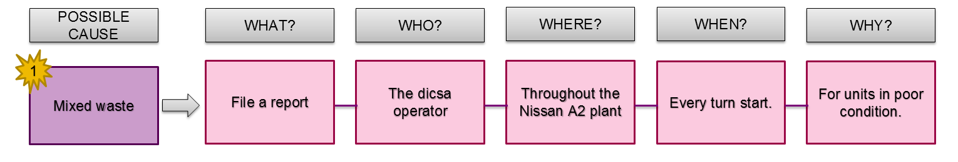
5.-Analysis
CONCLUTION:
What you want to avoid is the mixing of waste in the container modules, and time is one of the biggest factors in this problem.

Slide 9
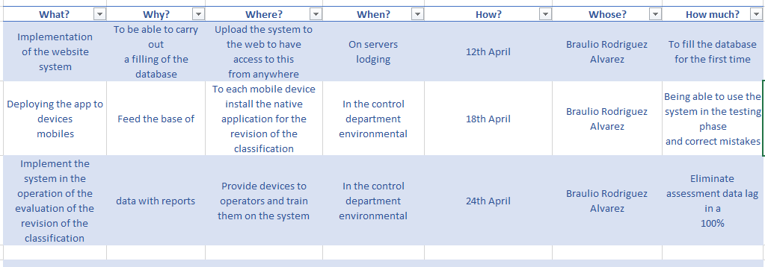
6.-Countermeasures-Corrective Action Plan
We elaborate a Pay off Matrix to prioritize the activities.
Implementation of the website system
Deploying the app to devices mobiles
Implement the system in the operation of the evaluation of the revision oh the classification
Easy
1°
2°
3°
Hard
under
high

Slide 10
9.-CONCLUSION-REVIEW AND FUTURE PLAN
We elaborate a Pay off Matrix to prioritize the activities.
Implementation of the website system
Deploying the app to devices mobiles
Implement the system in the operation of the evaluation of the revision oh the classification
Easy
1°
2°
3°
Hard
under
high

Slide 11
6.-Countermeasures-Corrective Action Plan
We elaborate a Pay off Matrix to prioritize the activities.
Implementation of the website system
Deploying the app to devices mobiles
Implement the system in the operation of the evaluation of the revision oh the classification
Easy
1°
2°
3°
Hard
under
high

Slide 12
6.-Countermeasures-Corrective Action Plan
We elaborate a Pay off Matrix to prioritize the activities.
Implementation of the website system
Deploying the app to devices mobiles
Implement the system in the operation of the evaluation of the revision oh the classification
Easy
1°
2°
3°
Hard
under
high

